Slide 1

Employee Management System
Presented by :
U.Chandrashekar
Batch No : 504

Slide 2
About me
I completed my Bachelor of Pharmacy from St pauls College of pharmacy
I joined Data Analysis course to Learn modern tools and techniques for the working data
and solve real-world problems.
So, far I have no experience
LinkedIn : linkedin.com/in/urkonda-chandrashekar-033189417
GitHub :
https://github.com/chandrashekar2898

Slide 3
Agenda
Business Problem
Problem Statement
Introduction
ER Diagram and Schema Explaination
SQL Queries Results
Business Key Insights
Conclusion
Recommendations
Q & A

Slide 4
Business Problem
Organizations often face challenges in managing employee records, payroll, qualifications, and leave data across multiple systems. This makes it difficult to generate accurate reports and gain insights for effective workforce management and decision-making.

Slide 5
Problem Statement
Develop a SQL-based Employee Management System that centralizes employee, department, payroll, qualification, and leave information. The system enables efficient data management and provides valuable insights to support HR operations and business decisions.

Slide 6
Introduction
The Developed a SQL-based Employee Management System to manage organizational data efficiently.
Integrated employee, department, payroll, qualification, and leave information into a centralized database.
Designed a relational database using primary keys and foreign key relationships.
Implemented SQL queries to retrieve, analyze, and generate business insights from employee data.
Performed payroll, salary, qualification, and leave analysis to support HR decision-making.
Applied SQL concepts such as JOINs, Aggregate Functions, GROUP BY, ORDER BY, and Constraints.
Improved data organization, consistency, and reporting capabilities within the system.
Enabled data-driven workforce management through analytical queries and reports. .

Slide 7
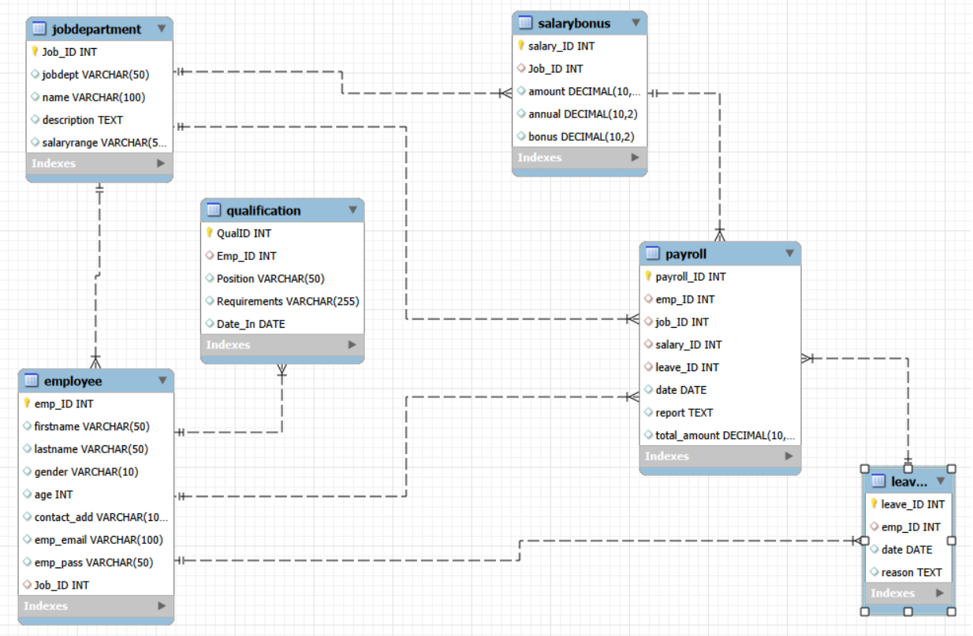
ER Diagram and Schema Explaination
Parent Table | Child Table | Cardinality
JobDepartment | Employee | 1 : Many (1:N)
Employee | Qualification | 1 : Many (1:N)
Employee | Leave | 1 : Many (1:N)
JobDepartment | SalaryBonus | 1 : Many (1:N)
Employee | Payroll | 1 : Many (1:N)
JobDepartment | Payroll | 1 : Many (1:N)
SalaryBonus | Payroll | 1 : Many (1:N)
Leave | Payroll | 1 : Many (1:N)

Slide 8
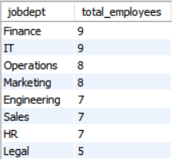
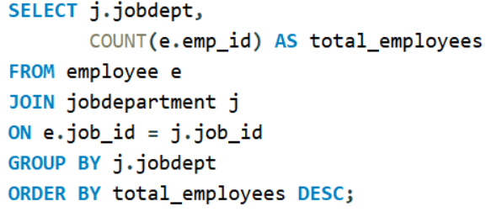
SQL Queries Results
01. Department-wise Employee Distribution :

Slide 9
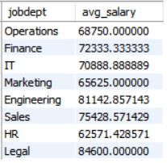
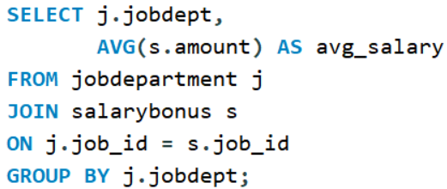
02. Average Salary by Department:

Slide 10
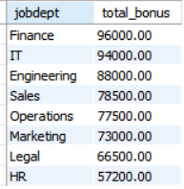
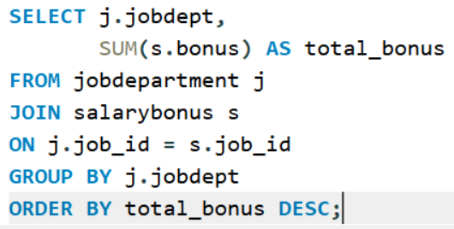
03. Department-wise Bonus Analysis :

Slide 11
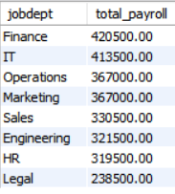
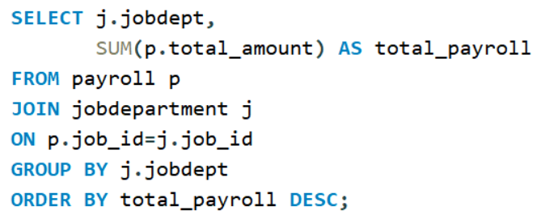
04. Highest Payroll Expenditure Department:

Slide 12
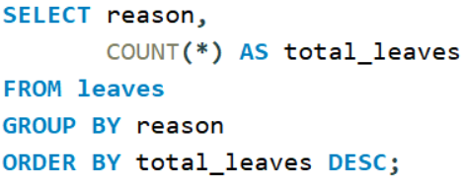
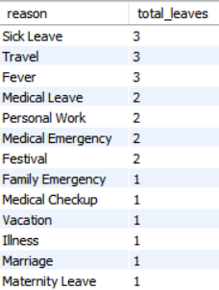
05. Most Frequently Leave Reasons occur :

Slide 13
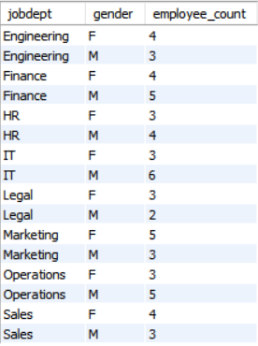
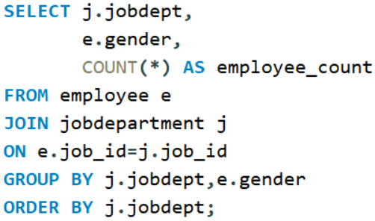
06. Gender Distribution Across Departments:

Slide 14
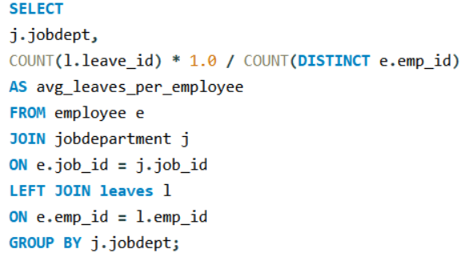
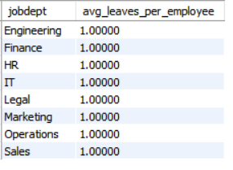
07. Average number leave days taken by employees per department:

Slide 15
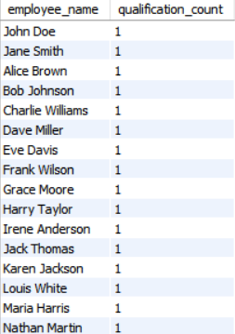
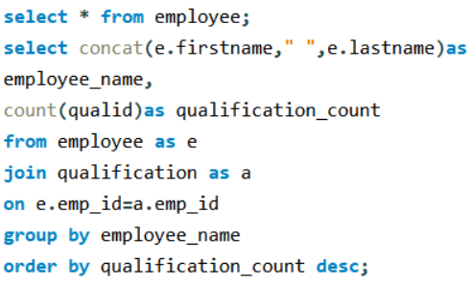
8. Employees highest number of qualifications:

Slide 16
Business Key Insights
Department-wise employee distribution helps identify workforce concentration and resource requirements.
Salary levels vary significantly across departments based on job roles and skill requirements.
Certain departments receive higher bonus allocations, reflecting performance-driven reward systems.
Payroll expenditure is concentrated in specific departments, making cost management and budgeting essential.
Employee leave patterns provide insights into absenteeism trends and workforce well-being.
Gender diversity varies across departments, supporting inclusive workforce planning and decision-making.
Departments with more qualified employees demonstrate stronger expertise and organizational capabilities.
Total payroll represents a major operational expense, highlighting the importance of effective compensation management..
Identifies the most qualified employees within the organization based on their qualifications,
Helps Hr recognoize skilled talent for promotions,leadership roles.
Identifies departments with higher employee leave frequency and helps management improve workforce planning and moniter employee attendance patterns

Slide 17
Conclusion
Developed an Employee Management System database to efficiently manage employee, department, payroll, qualification, and leave information within a centralized platform.
Utilized SQL operations such as joins, aggregations, grouping, and filtering to analyze workforce data and generate meaningful business insights.
Evaluated employee distribution, salary structures, bonus allocation, payroll expenditure, qualifications, and leave patterns to support HR and management decision-making.
Demonstrated how data-driven analysis can improve workforce planning, operational efficiency, compensation management, and overall organizational performance.

Slide 18
Recommendations
Implement a centralized employee management system to improve data accuracy, accessibility, and overall workforce management efficiency.
Regularly monitor payroll, salary, and bonus distributions to ensure fair compensation practices and effective budget utilization.
Introduce employee training and development programs to address skill gaps and enhance workforce qualifications across departments.
Analyze leave patterns and attendance trends to improve employee well-being, reduce absenteeism, and increase productivity.
Strengthen workforce planning by balancing employee distribution across departments based on operational requirements.
Promote diversity and inclusion initiatives by monitoring gender representation and ensuring equal opportunities across departments.
Utilize data-driven insights for strategic decision-making to optimize resource allocation, improve employee performance, and support organizational growth.

Slide 19


Slide 20

THANK YOU

